Slide 1

Stock Price Prediction
Present by
Jes Colbourne
Data Science & AI Program
Institute of Data

Slide 2
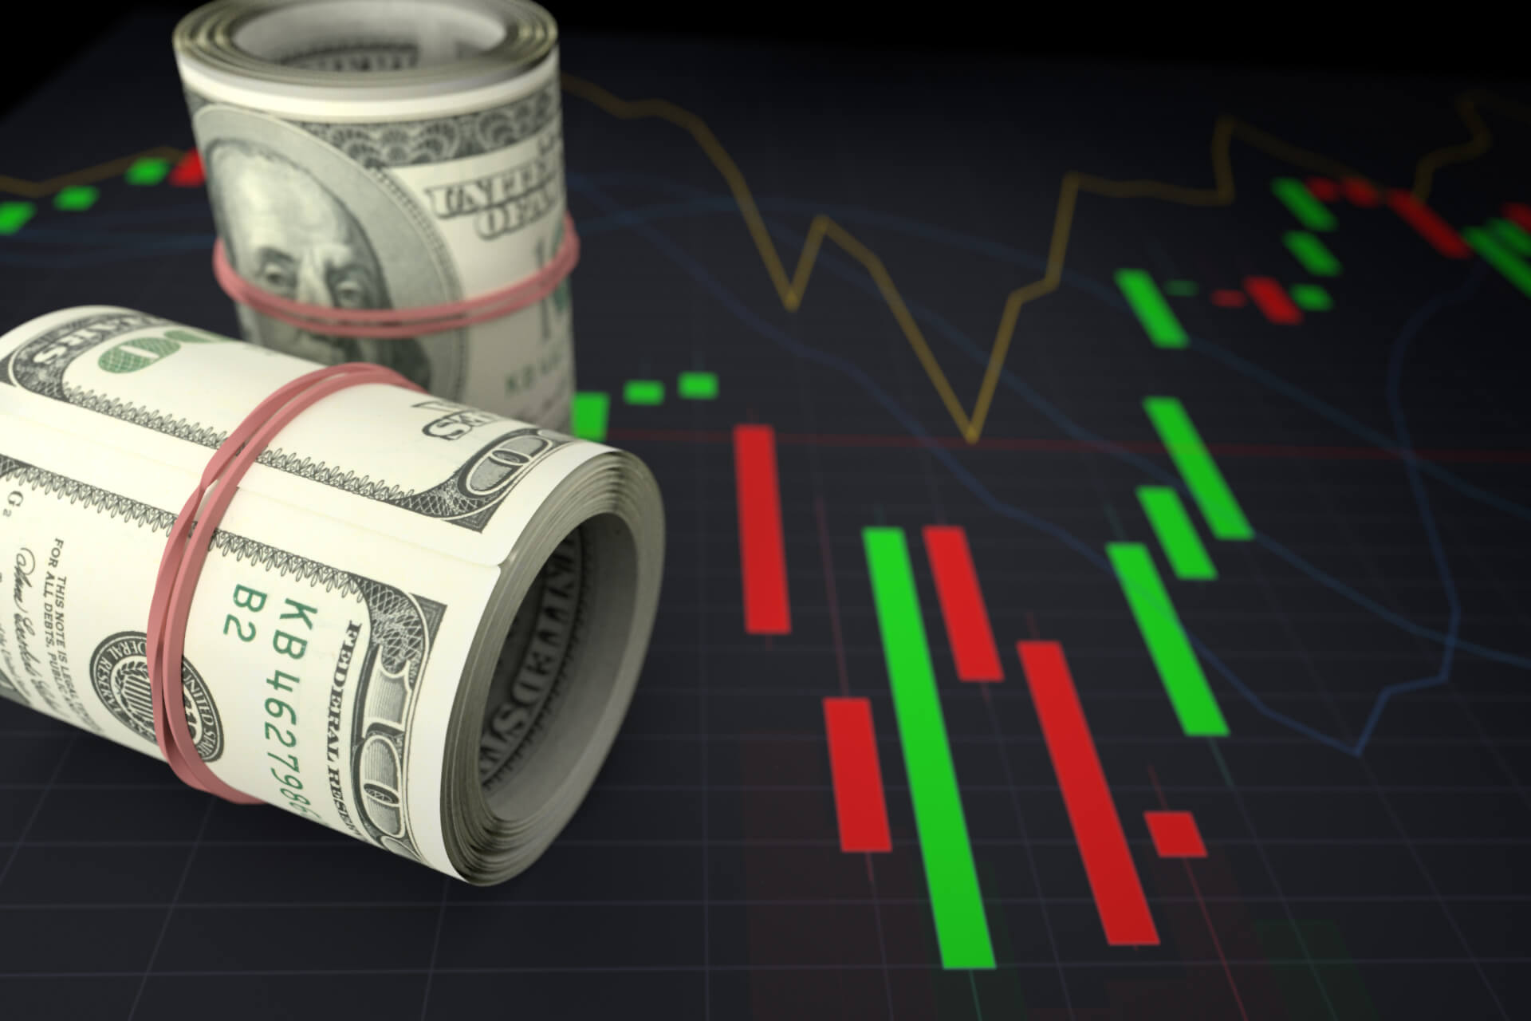
AGENDA
Biography
Business context
Dataset & Data pipeline
Data Science process
Deployment
Summary and recommendation

Slide 3

BIOGRAPHY
Jes Colbourne
Finance Officer
Education
Bachelor’s degree of Business Administration
Advanced Diploma of Naturopathy
Bachelor’s degree of Business (Accounting)
Data Science & AI Program
Professional experience
Over 5 years of health analysis and consultation in retail environment
Over 2 years of performance analysing and reporting of financial results

Slide 4
Business Context
Capitalization of listed Australian equity market is quite small comparing to other major overseas markets but our ratio to GDP ranks in the middle group with Japan and UK

Slide 5



ASX Australian Investor Study 2020
High value investors with median portfolio size of $1.2M
45% are women with median portfolio size of $90k
Next generation investor age 18-24 with median portfolio size of $50k

Slide 6
ASX Australian Investor Study 2020
Number of investors remained stable over the past 15 years
41% invest under $100k and 26% invest between $100k-$500k

Slide 7
ASX Australian Investor Study 2020
65% consider potential return on investment
86% invested within personal capacity

Slide 8


ASX Australian Investor Study 2020
41% prefer to receive investor education via YouTube

Slide 9





Problem statement
Key challenges for these investors are underperformance stocks, hidden fees, market volatility and information overload that may lead to the loss of investment.

Slide 10
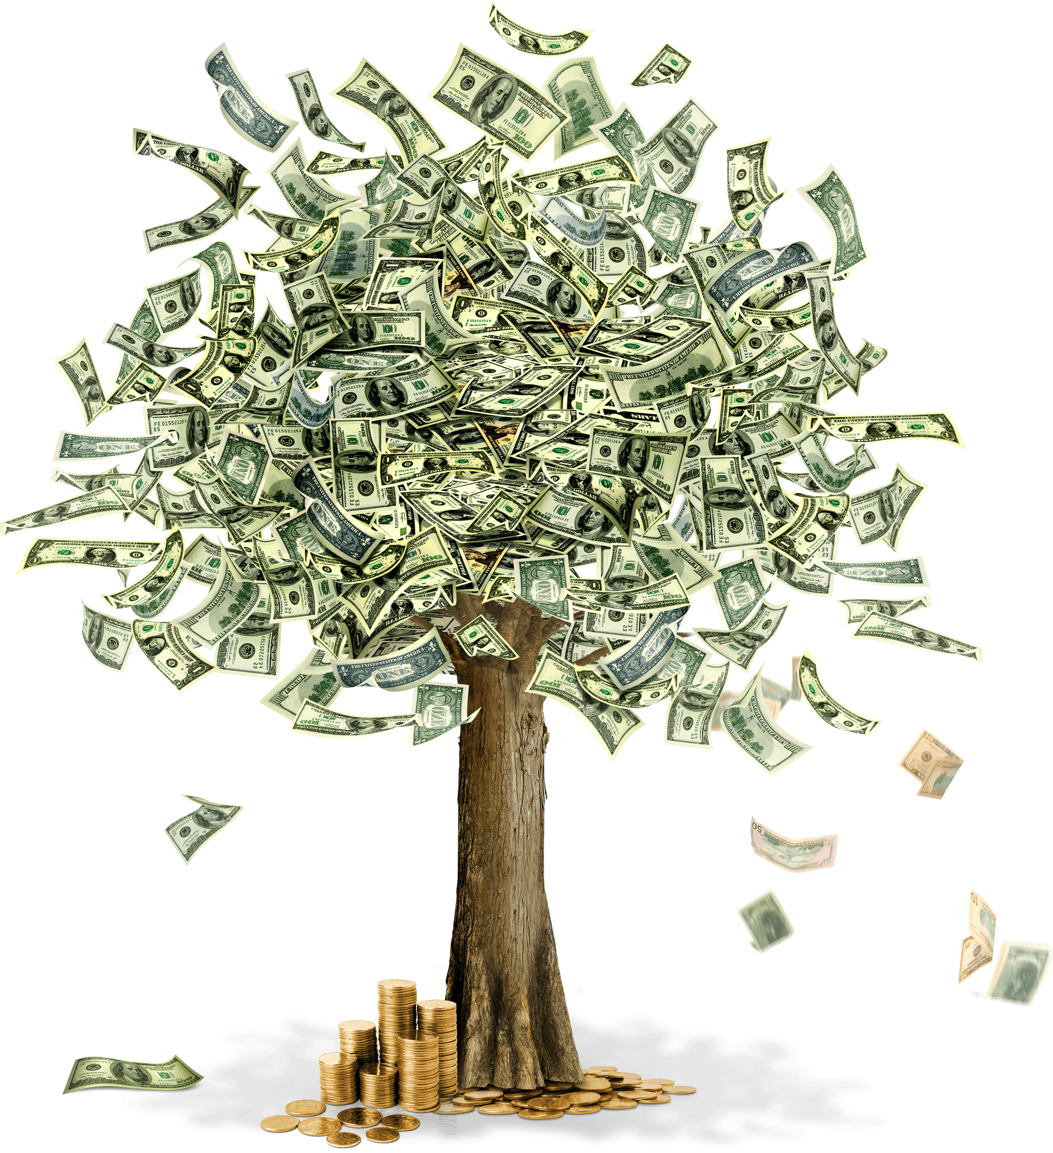

Business question
Can we predict stock price movement to increase returns on investment based on sentiment analysis?

Slide 11
Dataset & Data pipeline
Aztrazeneca Stock price history from 2003 to 2021
4,751 rows and 6 features plus one created (open, high, low, close, adj close, volume, and movement)
Data source – Yahoo Finance
Headline news from ABC news Australia from 2003 to 2021
1.2M rows and 2 features (date and headline text)
Data source – Kaggle.com
(https://www.kaggle.com/datasets/therohk/million-headlines?select=abcnews-date-text.csv)

Slide 12
Dataset & Data pipeline
Data Acquisition
Data Pre-Processing
Data Integration
Model Selection
Training
Comparison
Validation
Deployment
Decision Making
Evaluation

Slide 13
Dataset & Data pipeline : Trend of AZN Stock price and Volume
Commonwealth Bank of Australia stock price historical data from October 1991 to September 2022

Slide 14
Dataset & Data pipeline: Trend of Sentiment score and Stock price movement

Slide 15
Dataset & Data pipeline: Trend of Sentiment score and Stock price movement
Major events
2003 – SARS
2010 – Swine flu
2015 – MERS
2019 – COVID-19
Major events has direct effect on a spike of stock movement but has prolong effect on sentiment score of people

Slide 16
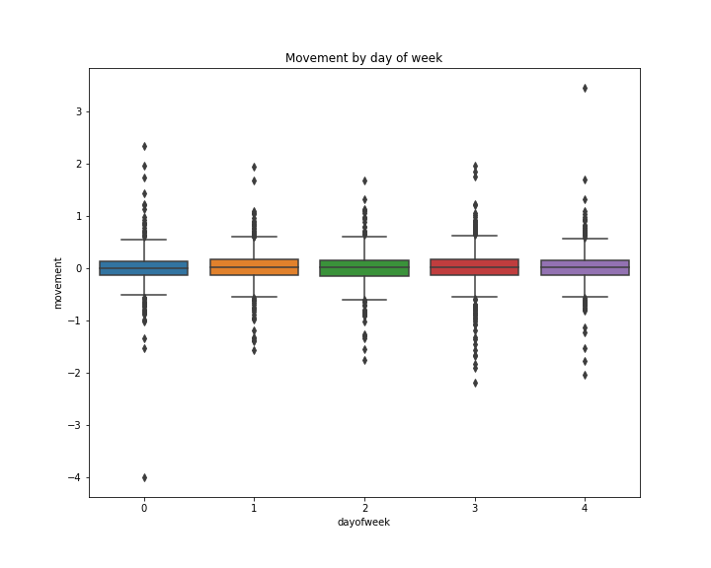
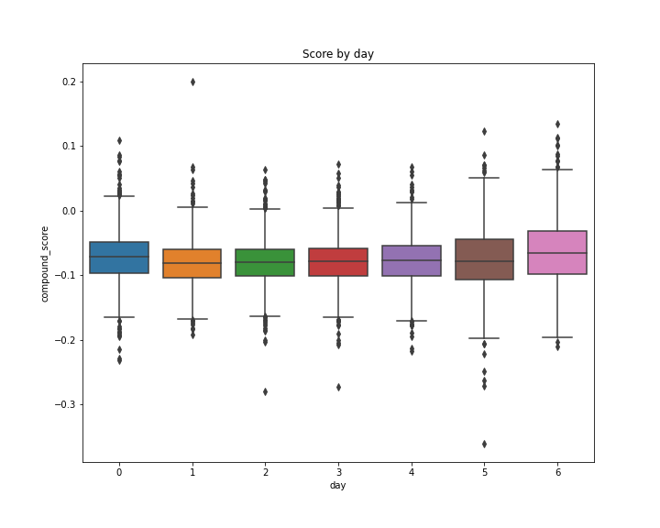
Data Science process: Key insights
Stock movement seem to be more negative on Thursday and more positive on Monday
Headline news seem to be more negative on Tuesday and more positive on Sunday

Slide 17
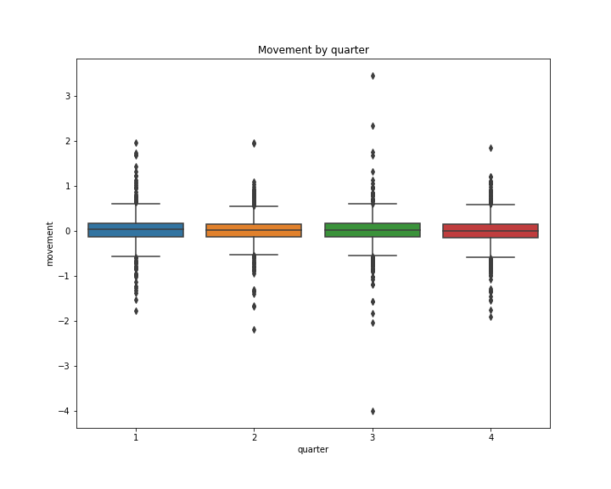
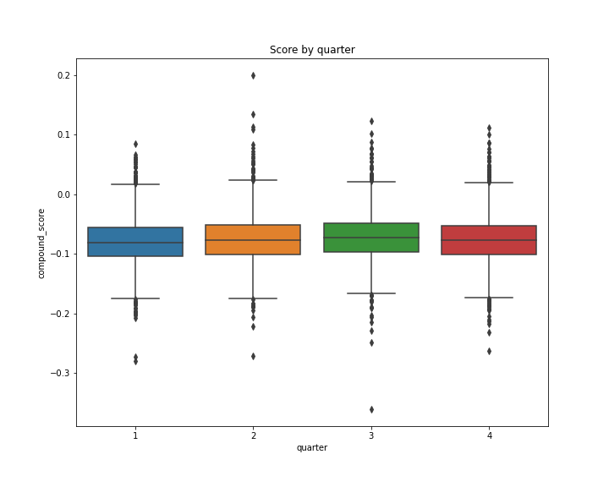
Data Science process: Key insights
Sentiment score moves slightly to the opposite direction to stock price movement in second quarter

Slide 18
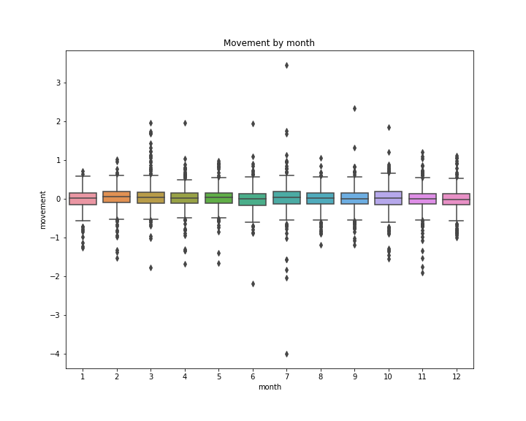
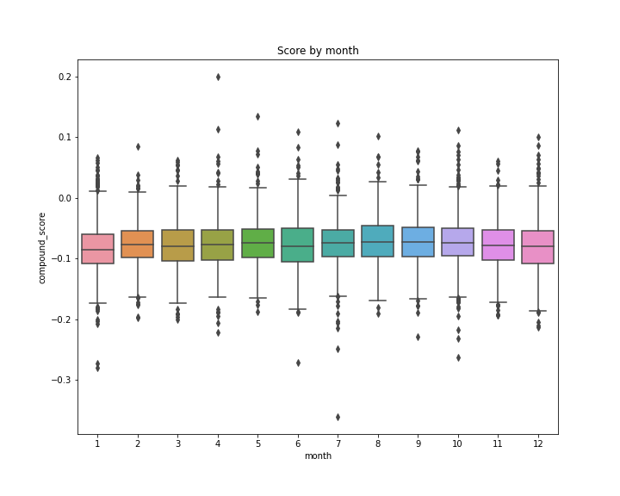
Data Science process: Key insights
Stock price has less movement if Sentiment score is more active

Slide 19
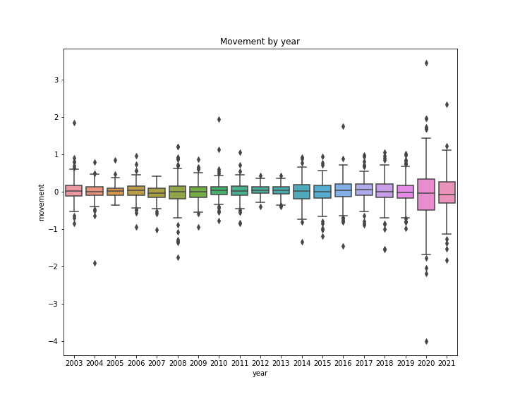
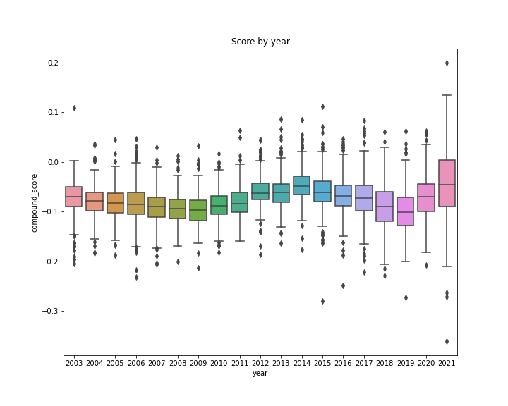
Data Science process: Key insights
Stock price movement vary ups and down over the years while sentiment score stays negative

Slide 20
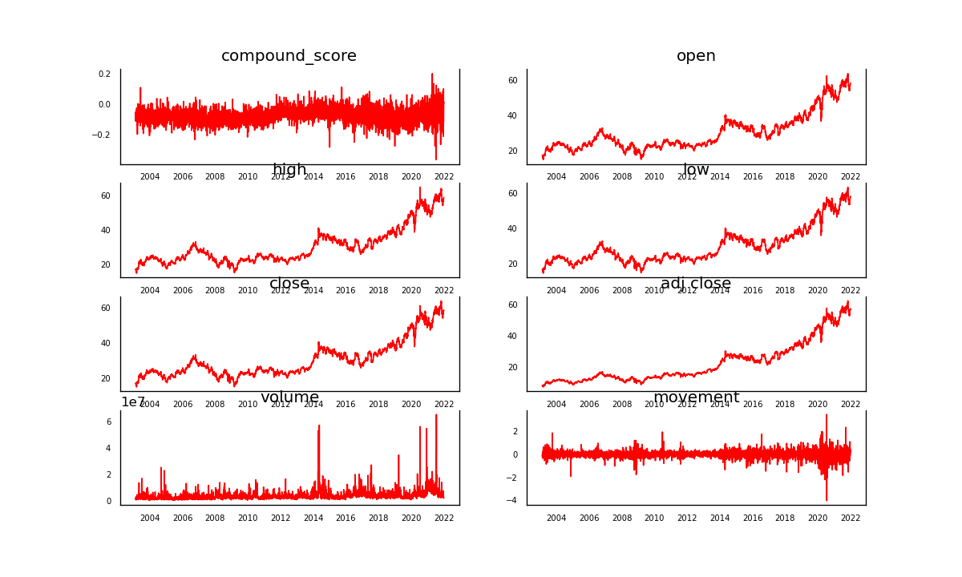
Data Science process: Feature correlation
Stock prices are highly correlated to each other while sentiment score share some similarity of trend with stock price movement

Slide 21
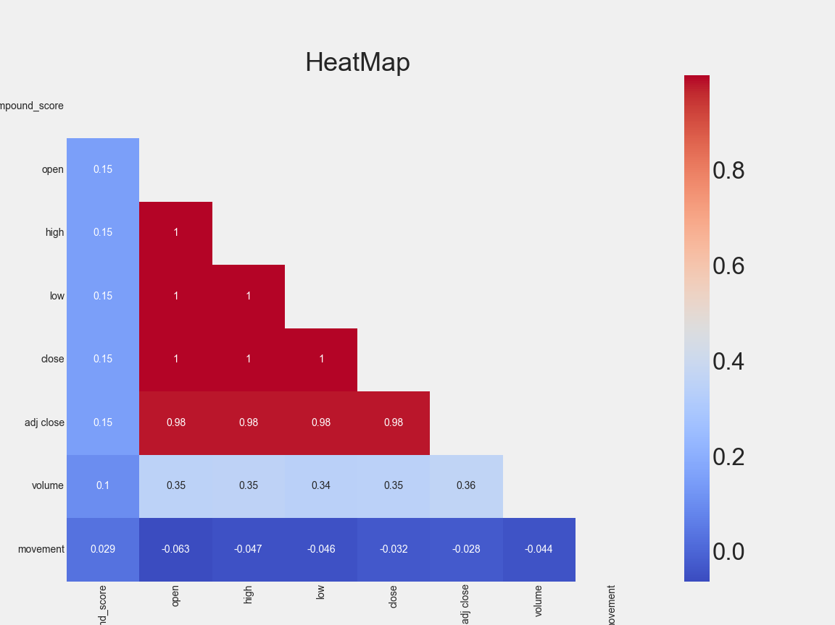
Data Science process: Feature correlation
Heatmap shows high correlation among stock price features.
Sentiment score has low to negative correlation to stock prices and movement

Slide 22
Data Science process: Model results With Sentiment Score
Best model: ARIMA (2, 1, 2)
Test set
RMSE: 0.1209
Test set
RMSE: 0.5649

Slide 23
Data Science process: Model results Without Sentiment Score
Best model: ARIMA (3, 1, 1)
Test set
RMSE: 0.1209
Test set
RMSE: 0.5425

Slide 24
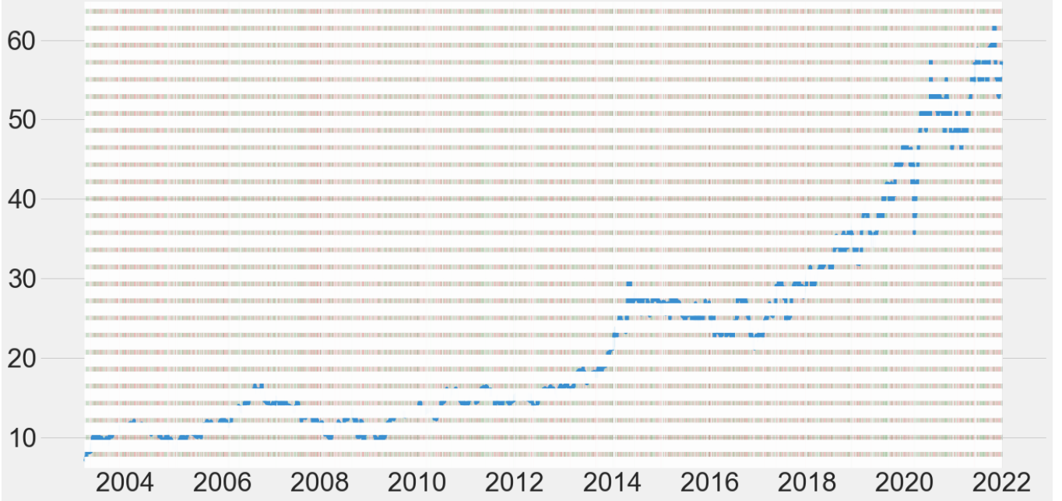
Deployment: Base model ARIMA (3, 1, 1)
Random buying: AZN stocks with $1,000 investment
Results:
Total value $3,079.59
Total return 207.96%

Slide 25
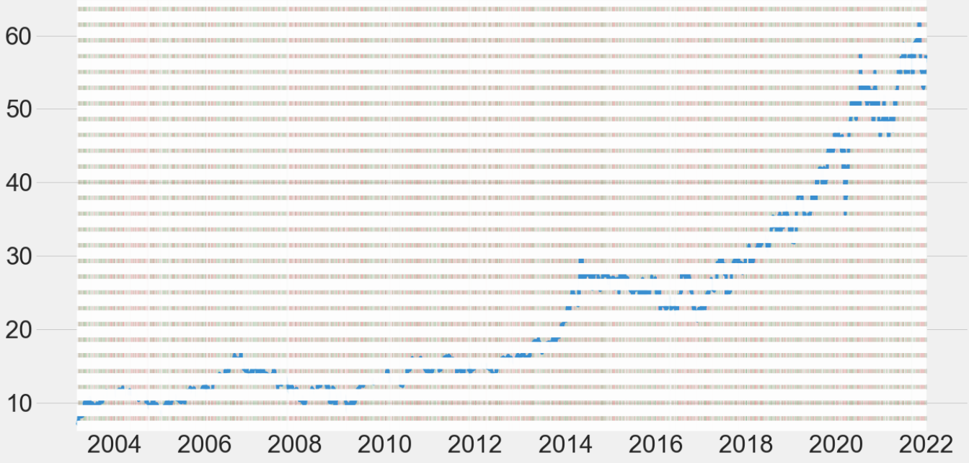
Deployment: Base model ARIMA (3, 1, 1)
Buy only if last return was positive: AZN stocks with $1,000 investment
Results:
Total value $636.88
Total return
-36.31%

Slide 26
Deployment: Qantas Stock trends of prices and returns

Slide 27
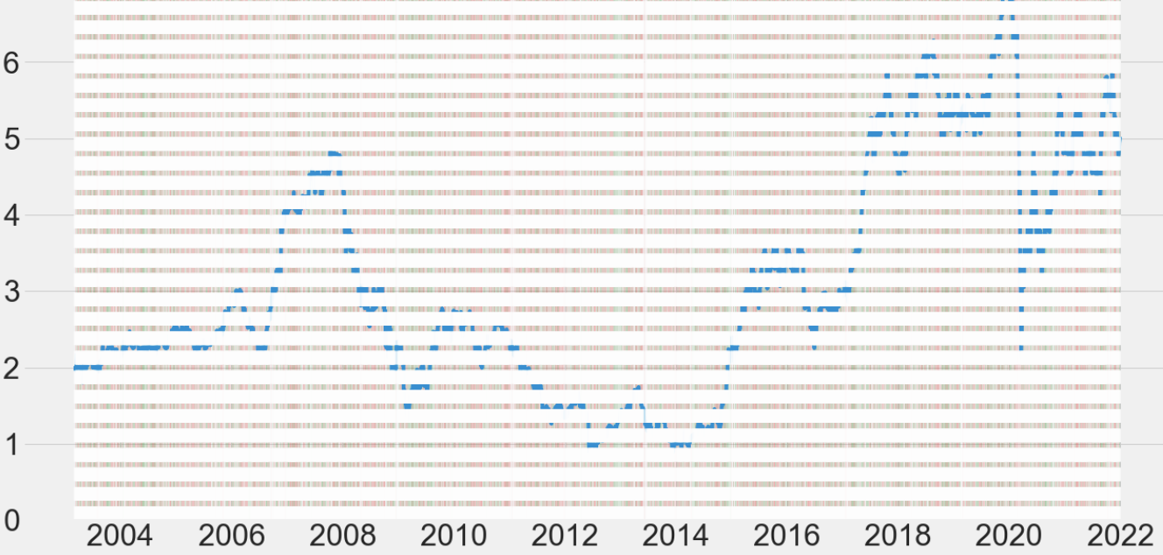
Deployment: Base model ARIMA (3, 1, 1)
Random buying: QAN stocks with $1,000 investment
Results:
Total value
$806.18
Total return
-19.38%

Slide 28
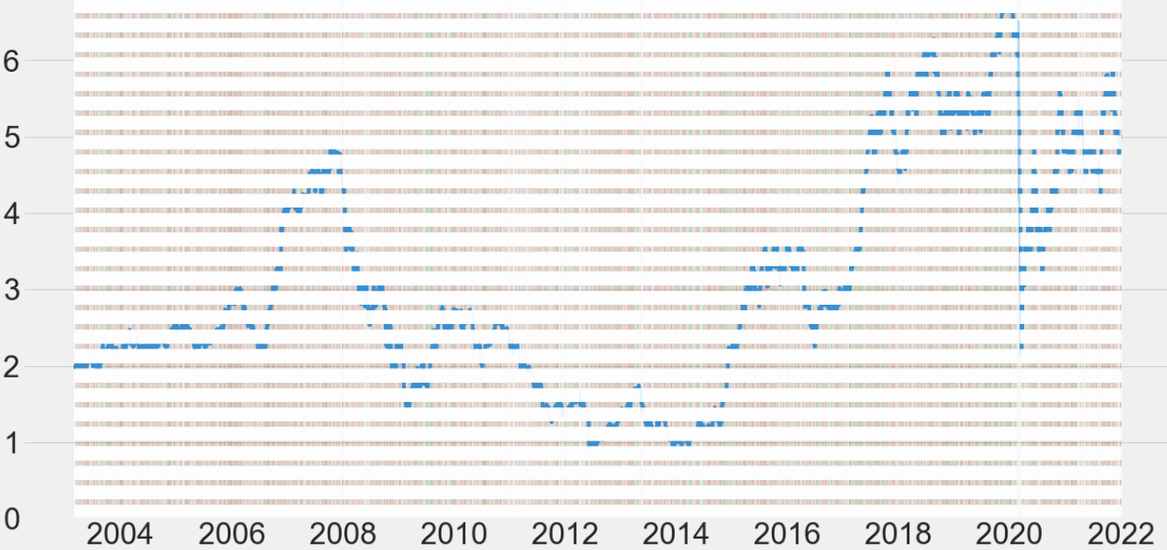
Deployment: Base model ARIMA (3, 1, 1)
Buy only if last return was positive: QAN stocks with $1,000 investment
Results:
Total value $1,348.64
Total return
34.86%

Slide 29
Summary : Business Question Answer
Best RMSE result was produced by model prediction without sentiment score
We may conclude that sentiment score possibly rather create white noise to the model than enhancing its results

Slide 30
Summary : Business Question Answer
Movement
Stock price movement prediction is possible when consider other factors that may have direct and indirect impact to the chosen stock based on its nature, industry and economic impacts around it.
Sentiment Score
Volume
Price

Slide 31
Summary: Business Question Answer
Invest time in data analysis to gain more domain knowledge of chosen stock, its market and overall economy
Analysing all features that may have direct and indirect impact on model results but keep the model simple to save on training time and maintenance
Invest time in training and tuning the model for better results

Slide 32
Next steps
Study technical analysis of market trend
Set up appropriate strategy of your investment plan
Test and set up rules-based strategy that is profitable
Optimise strategy outcome ie stop loss, buying target, risk-reward ratio, and time when the strategy work best
Risk management plan - managing the loss, keep you out of emotion when trade
Practice simulation/demo trading before investing real money
Discipline - don't gamble and stick to the strategy

Slide 33


Thank you ☺
-The End -

